Slide 1


Slide 2
JOINS
JOINS are used to retrieve data from multiple tables. It is performed whenever two or more tables are joined in a SQL statement.
INNER JOIN (or sometimes called simple join)
LEFT OUTER JOIN (or sometimes called LEFT JOIN)
RIGHT OUTER JOIN (or sometimes called RIGHT JOIN)
FULL OUTER JOIN (or sometimes called FULL JOIN)
CROSS JOIN (or sometimes called CARTESIAN JOIN)
TYPES

Slide 3
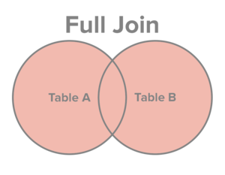
FULL OUTER JOIN
The FULL JOIN combines the results of both left and right outer joins
SELECT table1.column1, table2.column2...
FROM table1
FULL JOIN table2
ON table1.common_field = table2.common_field;
Syntax

Slide 4
FULL OUTER JOIN
The FULL JOIN combines the results of both left and right outer joins
SELECT
a.order_line ,
a.product_id,
a.customer_id,
a.sales,
b.customer_name,
b.age,
b.customer_id
FROM sales_2015 AS a
FULL JOIN customer_20_60 AS b
ON a.customer_id = b.customer_id
ORDER BY a.customer_id , b.customer_id;
Example

